Slide 1
COMP 2310 Data Structures and Algorithms
Lecture 5
Queue Structures

Slide 2
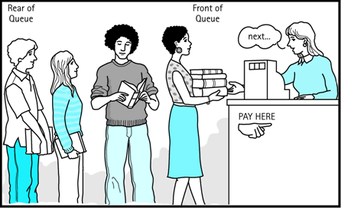

QUEUES

Slide 3
Conceptual View of a Queue
Adding an element
Front of queue
Rear of queue
New element is added to the rear of the queue

Slide 4
Conceptual View of a Queue
Removing an element
New front element of queue
Element is removed from the front of the queue

Slide 5
Queue Structures
Like a stack, a queue is an abstract data type that holds a linear sequence of elements.
There are two ends of a queue: front (Head), rear (back/tail)
In a queue, all insertions take place at the rear, all deletions take place at the front.
The elements are processed like customers standing in a check-out line: the first customer in line is the first one served.
→ first-in, first-out: FIFO

Slide 6
Queue Example: Printing Queue
A.doc, B.doc, C.doc arrive to printer.
C
B
A
Now printing A.doc
C
B
A.doc is finished. Now printing B.doc
D
C
B
Now still printing B.doc
D.doc comes
D
C
B.doc is finished. Now printing C.doc
D
C.doc is finished. Now printing D.doc

Slide 7
Queue Structure Operations
Common queue operations include:
Create an empty queue
enqueue(): Add a new item to the queue (Insert)
dequeue(): Remove an item from the queue (Delete)
isEmpty(): Check to see if the queue is empty.
isFull(): Check to see if there is more space for insertion.
Two index variables front and rear (back) specify the two ends of a queue.
Notes:
7

Slide 8
Queue Operations
Initially: front=rear=-1
createQueue()
enqueue(7)
enqueue(4)
enqueue(2)
front=0,rear=2 dequeue(7)
dequeue(4)
front=0,rear=0
7
7
4
7
4
2
7
4
2
4
2
2
Notes:
8

Slide 9
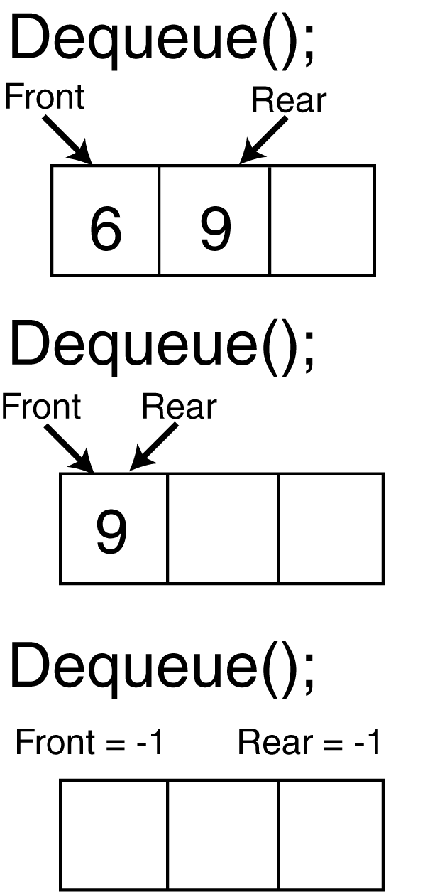
Queue Operations
After each insert/delete, the front or rear index has to be updated.
Example: Assume the queue contains: 4,6,9. front=0, rear=2.

Slide 10
Array Implementation Of Queues
Like stacks, queue structures can be implemented using an array.
We need to keep the positions of front and rear in two index variables.
Empty queue: front = rear = -1
After some operations the queue may look like this:
7
4
9
3
front
rear
Notes:
10

Slide 11
Array implementation of queues
FIFO is accomplished by inserting at one end and deleting from the other end
0 1 2 3 4 5 6 7
17
23
97
44
Queue
Front
Rear
To insert: put new element in location 4, and set rear to 4
To delete: take element from location 0, and set front to 1

Slide 12
Array implementation of queues: Example
front = 0
rear = 3
Initial queue:
17
23
97
44
After inserting 333
17
23
97
44
333
After deleting 17
23
97
44
333
front = 1
rear = 4
Notice how the array contents move to the right as elements are inserted and deleted
This will be a problem after a while! Why?

Slide 13
Problems of Array Implementation
A static array has limited size, once rear index is at the end of this array, and there are new items coming in, what can we do?
Two Solutions:
1. Shifting all items to front in the array to empty positions (Too Costly…)
2. Moving the rear index to the start of the queue
→ circular queue
A circular queue is implemented on a circular array.

Slide 14
Circular Queues
When a new item is inserted or deleted, the corresponding index has to be moved upwards.
After many insert and delete operations, the rear might reach the end of the queue and then no more items can be inserted.
However, the items from the front have been deleted and there is space there.
→Continue insertions from the front!

Slide 15
Circular Queues
Circular arrays are used to implement circular queue structures.
In circular queues, whenever front or back reaches the end of the array it is wrapped around the beginning.
→Both the front and the rear indexes wrap around to the beginning of the array.

Slide 16
Circular arrays
We use the array holding queue elements in circular form: The two ends are joined!
0 1 2 3 4 5 6 7
Queue
44
55
11
22
33
rear = 1
front = 5
Elements were added to this queue in the order 11, 22, 33, 44, 55, and will be removed in the same order

Slide 17
Example of a Circular Queue
front
After 5 dequeues
1
After 7 enqueues
1
0
0
front
12
12
11
rear
11
rear
10
10
rear
1
0
front
12
11
After 8 more enqueues
10

Slide 18
Circular Queue Operations
Initial state:
front
rear
4
8
4
8
front
rear
enqueue(2)
2
4
8
front
rear
4
8
2
rear
front
enqueue(3)
2
3
4
8
front
4
8
2
rear
rear
front
3
Notes:
18

Slide 19
Circular Queue Operations
front
dequeue(4)
2
3
8
8
2
rear
rear
front
3
dequeue(8)
2
3
front
2
rear
front
rear
3
dequeue(2)
3
front
rear
front rear
3
Notes:
19

Slide 20
Queue Operations: isEmpty and isFull
// Assume circular array implementation and queue capacity = n
bool IS_EMPTY()
if front == -1 and rear == -1
return true
else
return false
bool IS_FULL()
if front==0 and rear==n-1
return true
if ( front == rear + 1 )
return true
return false

Slide 21
Queue Operations: Enqueue
// Q size is n, Insert x.
// Assume Circular queue Enqueue(x)
if (isFull())
print ``Queue is full``
return
if (front==-1 and rear==-1)
front ← 0
rear ← 0
else
rear ← (rear+1)%N
Q[rear] ← x
Notes:
21

Slide 22
Queue Operations: Dequeue
// Remove x from the queue, size=n
Dequeue()
if isEmpty()
print ``Queue is empty``
then return
x ← Q[front]
if (front==rear)
front← -1
rear← -1
else
front←(front+1)%n
return x
Notes:
22

Slide 23
Queue Operations: Display
Display()
if isEmpty()
print ``queue is empty``
else
for(i=front ; i!=rear ; i=(i+1)%n)
print Q[i]
print Q[i]
Notes:
There is a final line of print here. If you make i!=real+1, then the code will stuck in infinite loop especially when the queue is full with front=0 and rear=n-1. in this case, i will be again 0 at the last iteration and the loop will be exacuted again.
23

Slide 24
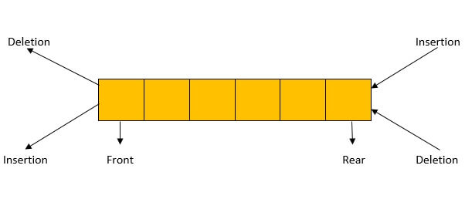
Double Ended Queues
Double Ended Queue is also a Queue data structure in which the insertion and deletion operations are performed at both ends.
That means, we can insert at both front and rear positions and can delete from both front and rear positions.
Often written as Deque and pronounced like "deck" to avoid confusing it with Dequeue Operation

Slide 25
Double Ended Queues: Operations
insertFront: Insert or add an item at the front of the deque.
insertLast: Insert or add an item at the rear of the deque.
deleteFront: Delete or remove the item from the front of the queue.
deleteLast: Delete or remove the item from the rear of the queue.
getFront: Retrieves the front item in the deque.
getLast: Retrieves the last item in the queue.
isEmpty: Checks if the deque is empty.
isFull: Checks if the deque is full.

Slide 26
Priority Queues
The queues that we have considered so far are “Honest” queues: All operations are FIFO.
In real life this may not be realistic or practical and some elements or operations may have priority over the others.
Consider two queues:
one is high priority queue
the other is low priority queue
Service rules:
Start service from the high priority queue
If there are no elements in the high priority queue, then begin serving the low priority queue

Slide 27
Two Queues with Different Priorites
High Priority Queue, will come in hpQue
Low Priority Queue, will come in lpQue
High Priority Queue
Check In
counter
Customers coming in
H
D
C
H
G
F
E
D
C
B
A
G
F
E
B
A
Low Priority Queue
Check-in begins with hpQue, when it becomes empty, service in lpQue starts.

Slide 28
Priority Queue Implementation
Priority queues are more specialized data structures than a stack or a simple queue.
In a priority queue, items are ordered by a key value, in such a way that, the items with the lowest key (or the highest) are always at the front.
→The items with minimum key have the highest priority.
Items are inserted/deleted in the proper position according to the key values to maintain the order.
Notes:
28

Slide 29
Priority Queue Example: Air Travel Check-In
Assume there is only one check-in service in THY counter at some airport.
Two waiting lines (Queues) for passengers are formed:
One is First class service
The other is Economy class service
Passengers in the first-class waiting line have higher priority to check-in than those in the economy-class waiting line.

Slide 30
Pseudocode For Arrival
Priority Queue Passenger Arrival:
if (new Passenger comes) {
if(is FirstClass)
hpQue.enqueue(new Passenger);
else
lpQue.enqueue(new Passenger);
}

Slide 31
Pseudocode for Priority Queue Service
Priority Queue Check-In Service:
if( !isEmpty(hpQue) ) {
serve the passenger from high priority queue
hpQue.dequeue();
}
else {
serve the passenger from low priority queue
lpQue.dequeue();
}

Slide 32
Computer Applications of Queues
In a multi-user system, a queue holds print jobs submitted by users. The printer services those jobs one at a time (FIFO).
Communications software uses queues to hold information received over networks:
If information is transmitted to a system faster than it can be processed, it is placed in a queue.
Job scheduling in operating systems.
Simulation of real-world situations.

Slide 33
Computer Applications of Queues
Priority queues are used in various ways in certain computer systems.
Multitasking operating systems: Schedule of jobs on a shared computer. Some jobs will be more urgent than others. A priority queue keeps track of the jobs to be performed and their priorities. If a job is finished or interrupted, then one with highest priority will be performed next.
Networking: Managing limited bandwidth on a transmission line. In the event of outgoing traffic queuing due to insufficient bandwidth, all other queues can be halted to send the traffic from the highest priority queue upon arrival.
Priority queues are best implemented with a data structure called a heap.
Notes:
33

Slide 34
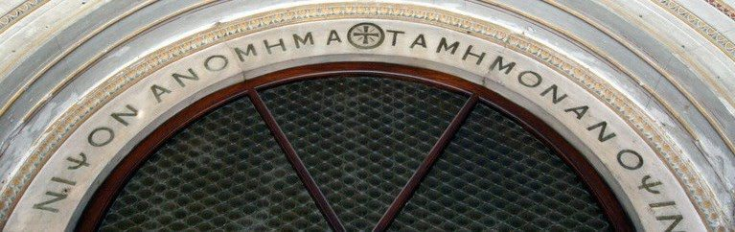
Queue Appplications: Recognizing Palindromes
A palindrom is a string of characters which reads the same backwards and forwards.
Examples: eye, madam, racecar, no lemon, no melon
Was it a car or a cat I saw?
NIPSON ANOMIMATA MI MONANOS PIN
(Means: wash your sins not only your face.
Written on a fountain in Hagia Sofia (Ayasofya Mosque) in Istanbul)
Notes:
34

Slide 35
Queue Appplications: Recognizing Palindromes
We can use both a stack and a queue to find out whether a string is a palindrome or not.
Starting from the first character of a string and travesing from left to right we insert each character into both a stack and a queue.
Characters removed (popped) from the stack will be in the opposite order.
Characters removed (dequed) from the queue will be in the original order.
Notes:
35

Slide 36
Appplications: Recognizing Palindromes
Based on this information;
If the characters at the top of the stack and at the front of the queue are compared and found to be the same then we can delete both of them.
This process is continued until the end of the string.
Finally if
The stack and the queue both are empty then the original string is a palindrome.
Otherwise the string is not a palindrome.
Notes:
36

Slide 37
Recognizing Palindromes: Pseudocode
//Str contains the string to be checked
IsPalindrome (Str)
CreateQueue(Q) , CreateStack(S)
n ← length[Str]
for i ←1 to n
do nextchar ←Str[i]
Enqueue (nextchar)
Push(nextchar)
// Compare the queue characters with stack characters
charactersSame ←TRUE
while Q is not empty and charactersSame
x ← Dequeue() // x=Q[front]
y ← Pop() // y= S[top]
if x != y
charactersSame ←FALSE
return charactersSame
Notes:
37

Slide 38
Appplications: Recognizing Palindromes
String: ADBCB
Queue
A D B C B
front
back
B
C
B
D
A
top
Dequeue : X=A
Pop stack: Y=B
X != Y
Not a palindrome !
Stack
Notes:
38

Slide 39
Appplications: Recognizing Palindromes
String: MADAM
Queue
M A D A M
front
back
M
A
D
A
M
top
X=M
Y=M
X=Y
…………..
Stack
MADAM is a palindrome !
Notes:
39

Slide 40
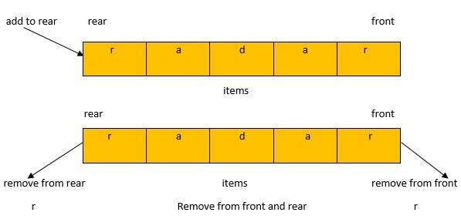
Using Deque (Dec) for Palindrom Checking
The front of the deque will hold the first character of the string and the rear of the deque will hold the last character. Since we can remove both of them directly, we can compare them and continue only if they match. Example:

Slide 41
Running Time of Queue Operations
Consider simple array implementation:
A single item can be inserted and deleted from a queue in O(1) time.
Inserting or deleting n elements in a queue is O(n).

Slide 42
Dynamic Data Structures
Storage for all elements of a static array is allocated together as one fixed block of memory.
If insertions and deletions are frequent, array implementation is not a good choice because of the need for several shift operations.
Shifts at run time are costly (Take time).
What can be done to overcome disadvantages of the static array implementations?
The answer is dynamic data structures whose sizes can change at run time.

